Slide 1

Wanaw Tena Telehealth Services Provider
Book Appointment & get consults from any time, any where; Web based Hippa Compliant EMR Integration; Comprehensive Coverage of Various medical conditions & AI Assistant.

Slide 2



Services Given By Wanaw Tena
Electronic Health Records(EHR)
Telehealth Platforms
Online Appointment Scheduling
By allowing health care providers to interact(Virtual consultations, Monitoring, Education and support) with patients in real-time through Sms, Video & voice call.
Provide a digital version of a patient's paper chart, Real-time and Patient-Centered System That Provides secure and Instant Access.
By allowing Patients to process booking appointments through Phone calls, Sms & internet.

Slide 3










Building Anticipation: The Journey So Far
Innovative Design
Strategic Planning
Dedicated design phase focused on Interoperability, aesthetics, usability, scalbilty and responsiveness.
Weeks of meticulous planning, conceptualization, and strategic development.
Rigorous Development
Our team diligently coded and built the platform from the ground up.
Excitement Countdown
Launched a thrilling countdown, building buzz and anticipation for today's launch.
Community Engagement
Shared behind-the-scenes sneak peeks and engaged our community on social media.

Slide 4
What’s New? Key Features & Improvements
HIPAA/GDPR compliance: End-to-end encryption, role-based access control, anonymized health records.
Smart Features: AI-based symptom checker, patient triage, decision support.
Telemedicine: Built-in video consultation, e-prescriptions, lab result integration.
Interoperability: HL7 FHIR standards for data exchange.
National ID(Fayda) Integration: Use National ID as a primary Key for multiple Services.

Slide 5
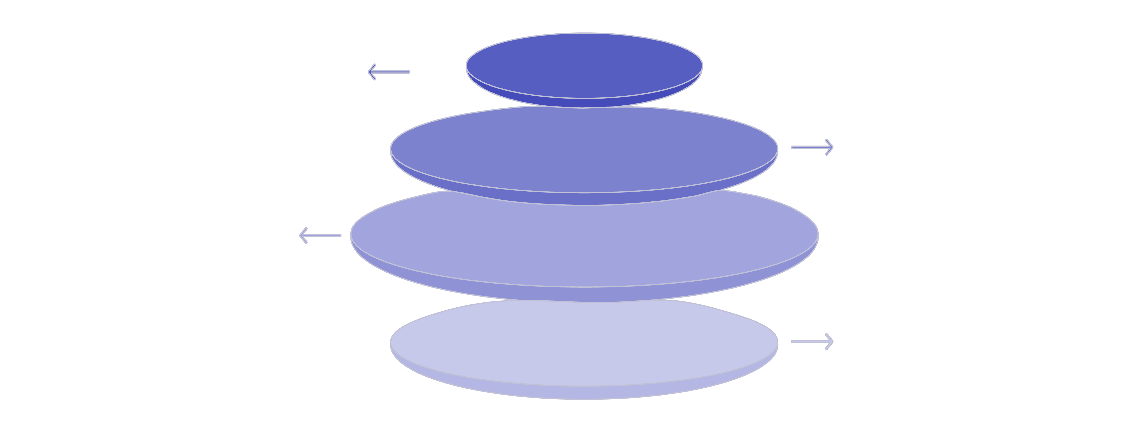
How It Benefits You
Faster Loads
Improved speed for quick access
Intuitive Layout
Personalized Content
Clear navigation and UX
Custom recommendations for users
Secure Platform
Protected data and transactions

Slide 6
🚀 MVP Features
1
2
3
Patient registration via National ID
Doctor dashboard
Multilingual interface (Amharic, English)
(case notes, history)
4
5
6
Appointment booking
Patient portal
Medicine inventory system

Slide 7




Then scale up to:
AI-powered symptom checker & triageStay
Telemedicine module
National EHR integration
Offline-first clinic support

Slide 8
Tech Stack
Frontend
AI/ML Services
React + Tailwind CSS, PWA-ready, i18n localization.
OpenAI API, LangChain (optional for smart assistant)
Backend
Hosting
Node.js + Express.js + Hapi
Render / Railway / Firebase / AWS
Database
Security
MongoDB (with encryption) or mysql
JWT, HTTPS, Role-Based Access, Rate Limiting

Slide 9

Thank You for Being Part of This Journey!

